Slide 1
Incremental Unit Testing
STAP Group
Shanghai Jiao Tong University

Slide 2
Agenda
Introduction
Design
C++ IUT Implementation
Java IUT Refinement
Demo
Future Work

Slide 3
Agenda
Introduction
Design
C++ IUT Implementation
Java IUT Refinement
Demo
Future Work

Slide 4
Introduction
Version 1
Version 2
A small piece of
code change
Test case
Test case
All test cases
Rerun all
test cases?

Slide 5
Introduction
Revision 1
Revision 2
A small piece of
code change
test case
test case
test cases
affected by
the chage
All test cases

Slide 6
Agenda
Introduction
Design
C++ Implementation
Java Refinement
Demo
Future Work

Slide 7
Design
Instrument original codes to log the function coverage of every test case and store them to database.
Find differences between two versions of codes at function level.
Rerun the test cases that cover the changed codes.

Slide 8
Workflow Overview
Preprocessing
Incremental Testing
Original Source
New
Source
Instrumenting
Diff
Diff Result
Test Case
Instrumented
Source
Affected Test Case
Lookup
Coverage
Log
Execute
Execute
Update
Database

Slide 9
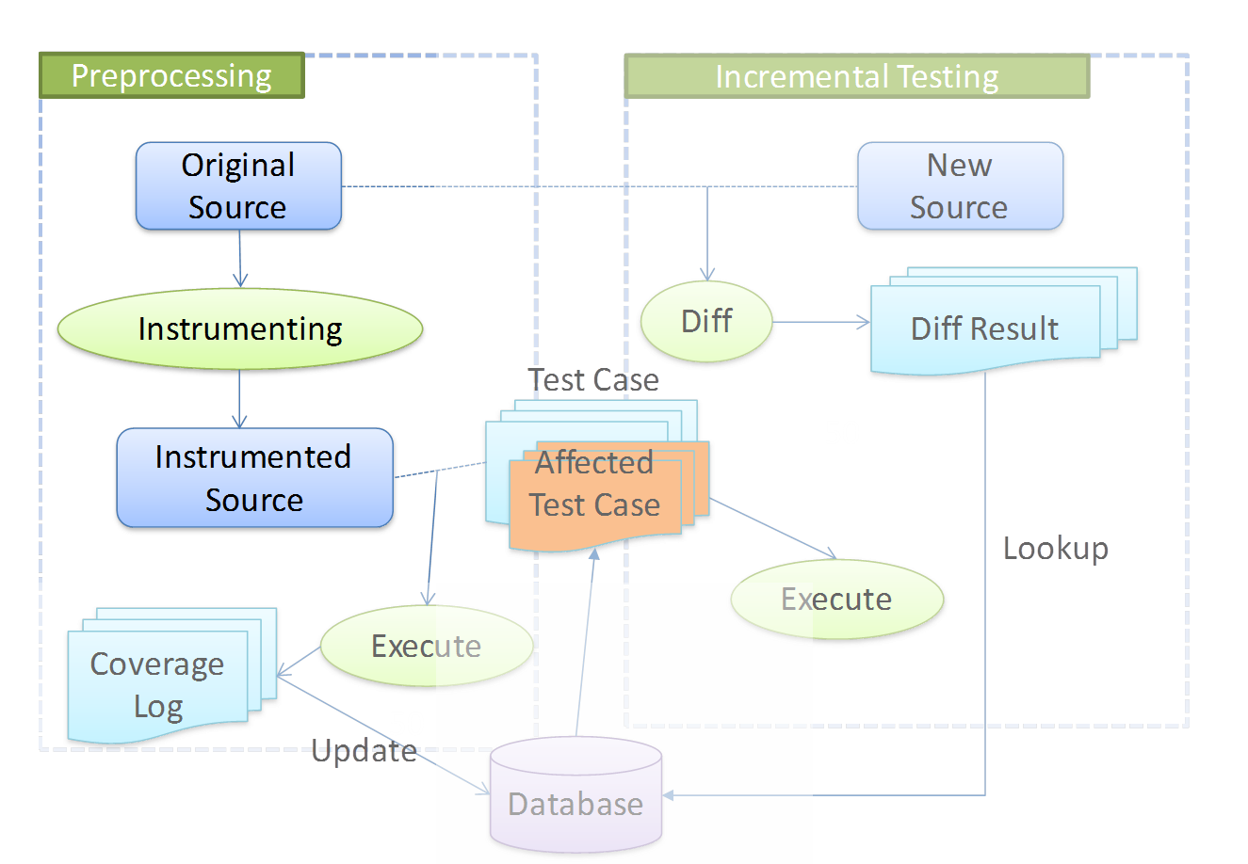
Instrumentation
Find all functions via AST(Abstract Syntax Tree).
Insert a logging statement at the beginning of every function to print out the signature of the function.

Slide 10
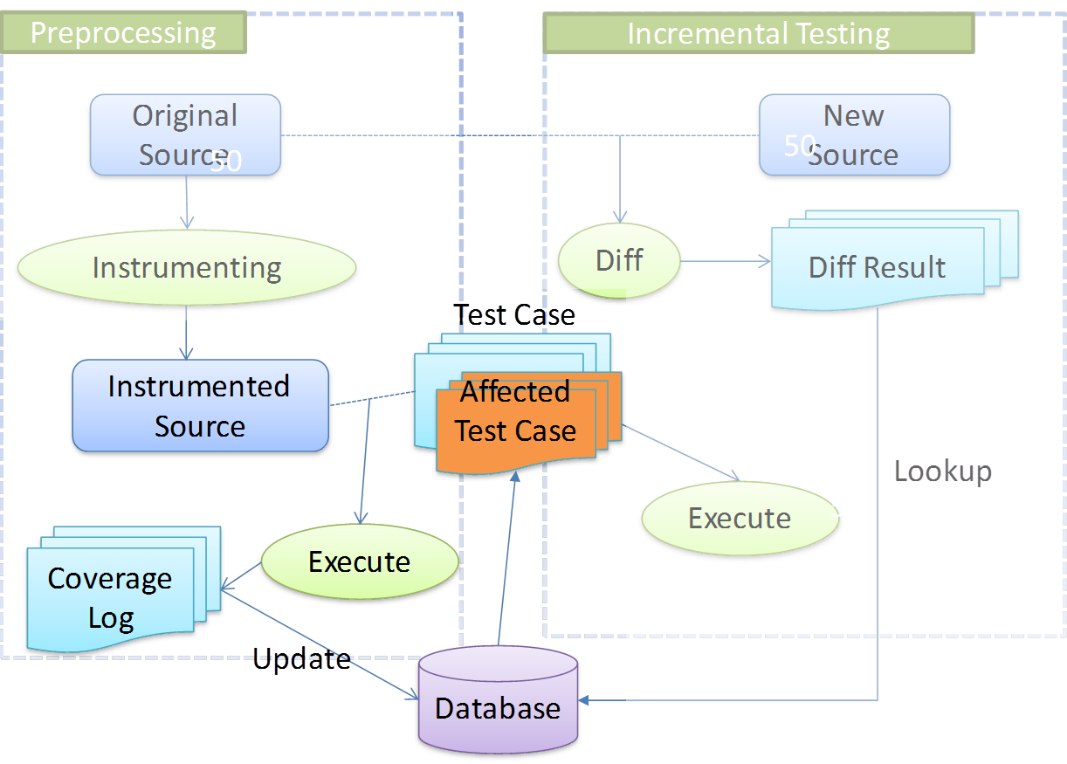
Coverage
Run the test cases along with instrumented codes.
Parse the coverage log for functions covered by each test case.
Store the coverage information to database.

Slide 11
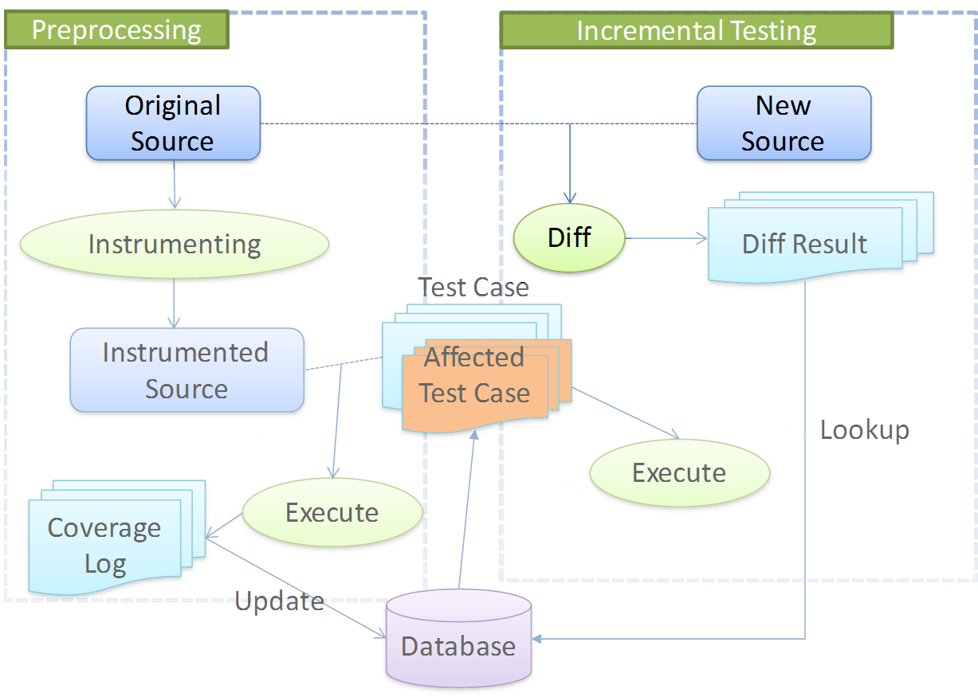
Diff
Transform source into AST.
Compare AST structures and contents.

Slide 12
Differ Result
File
Added: rerun all test cases
Modified:
Function
Other elements
Deleted: rerun all test cases
Function
Added: rerun all test cases
Modified: rerun affected test cases
Deleted: rerun all test cases
Other element
any change: rerun all test cases
Notes:
smart art

Slide 13
Differ Result
File
Added: rerun all test cases
Deleted: rerun all test cases
Modified:
Function
Added: rerun all test cases
Modified: rerun affected test cases
Deleted: rerun all test cases
Other elements
Any change: rerun all test cases
Notes:
smart art

Slide 14
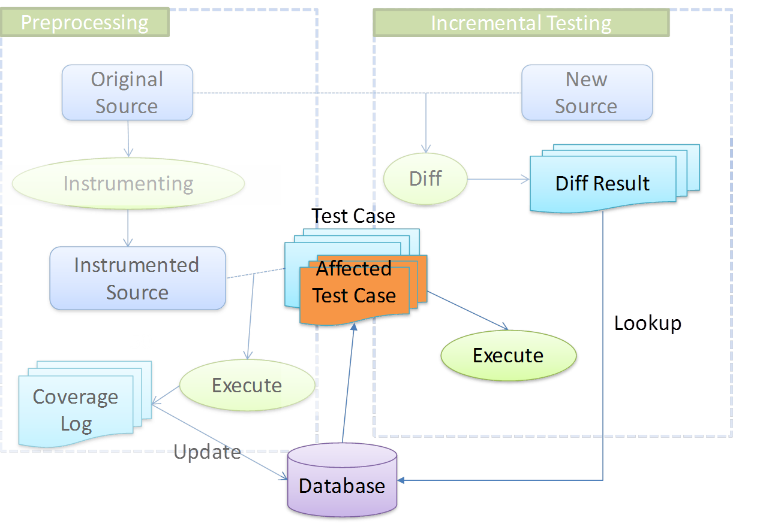
Select
Select(coverage, difference) -> test cases.
Rerun affected test cases.

Slide 15
Source
Test Cases
Covered Functions
Modified Functions
Affected Test Cases
Notes:
raw

Slide 16
Agenda
Introduction
Design
C++ IUT Implementation
Java IUT Refinement
Demo
Future Work

Slide 17
C++ IUT Implementation
A command-line tool ‘iutc’
Support executing two phases separately by specifying different command options.
Using Eclipse CDT to parse source code and generate AST.
Using sqlite3 as database to save record
Notes:
构建工具是什么

Slide 18
Command Options
Compulsory
iutc –c
Execute Preprocessing phase.
iutc –s
Execute Incremental testing phase.
Optional
iutc –i
Initialize a configuration template file for current project.
iutc –h
Print help information.
Notes:
构建工具是什么

Slide 19
Implementation Status
Basic incremental unit testing tool for C++ Project
Instrumentation source code for logging
Find Function level difference between two source folder
Maintain a database to keep track the relationship between test cases and functions
A bash script to support the workflow

Slide 20
Limitations
Only available for projects that use Google Test framework
After rerunning the affected test cases or rerunning all test cases, the iut program doesn’t update the running result to the database.

Slide 21
Agenda
Introduction
Design
C++ IUT Implementation
Java IUT Refinement
Demo
Future Work

Slide 22
Java IUT Refinement
Reduce the previous command options from 7 to 3.
Phase | New Command | Old Commands
Phase1: Preprocessing | iutj -i <projectName> | iut init <projectName>
 | iutj -c <projectName> | iut inst iut gentest iut testall iut update
Phase2: Incremental Testing | iutj –s <projectName> <oldVersionPath> <newVersionPath> | iut diff <oldVersionPath> <newVersionPath> iut itest
Notes:
改命令

Slide 23
Former Java Workflow
Preprocessing
Incremental testing
init
Origin source
New
source
diff
Diff result
inst
Instrumenting
diff
AffectedTest case
Lookup
Instrumenting
original source
itest
Execution
log
Database
rebuild
Execute
Test case
Update
gentest
testall
update
iut command options

Slide 24
Simplified Java Workflow
Preprocessing
Incremental testing
-i
-s
Origin source
New
source
-c
diff
Diff result
Instrumenting
AffectedTest case
Lookup
Instrumenting
original source
Execution
log
Database
rebuild
Execute
Test case
Update
iut command options

Slide 25
Agenda
Introduction
Design
C++ IUT Implementation
Java IUT Refinement
Demo
Future Work

Slide 26
DEMO
Demo Project: CCTZ
Size: 6576 LOC, 71 test cases
Source: github.com

Slide 27
Agenda
Introduction
Design
C++ IUT Implementation
Java IUT Refinement
Demo
Future Work

Slide 28
Future Work
Support smooth multi-version evolution. Now the demo are based on two version.
Identify and analyze more special cases when comparing versions of codes.
Integration with version control system.

Slide 29
Final Deliveries
Artifacts | Estimated Hand Over Time
Source code for C++ IUT Improved workflow (shell script) Sample project | 16/8/1
Design document | 16/8/1
User manual | 16/8/1
Notes:
填好

Slide 30
Conclusion
We have implemented a tool to support all basic functionalities of the incremental unit testing for C++ projects.
We have simplified the workflow of incremental unit testing, and applied it to both the C++ and the former Java IUT project.
There are still a few limitations in this version, expecting further enhancement in the future.

Slide 31
Thanks to Morgan Stanley for supporting the project!

